Slide 1
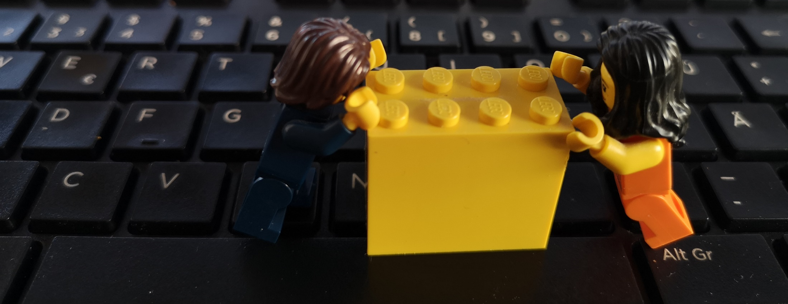
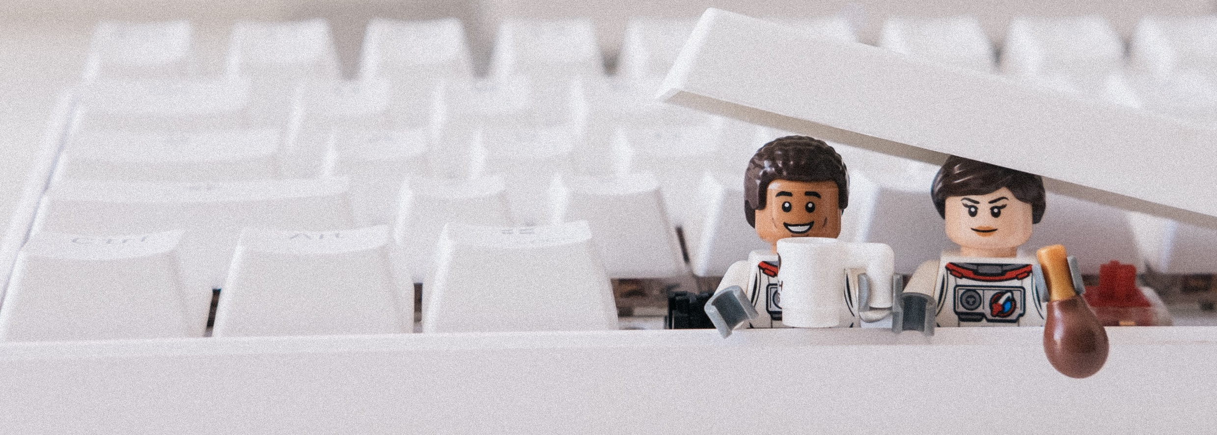
RSelenium or shinytest
How to make shiny apps ready for use in a regulated environment
Sebastian Wolf – @zappingseb – @earlconf – Sep 12th 2019

Slide 2
Is this about tools?
YES!

Slide 3
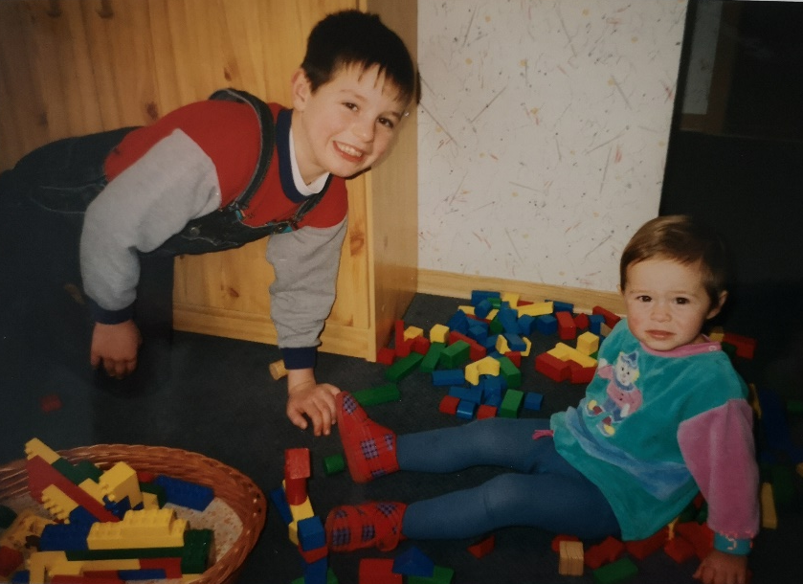
What kind of tools?

Slide 4
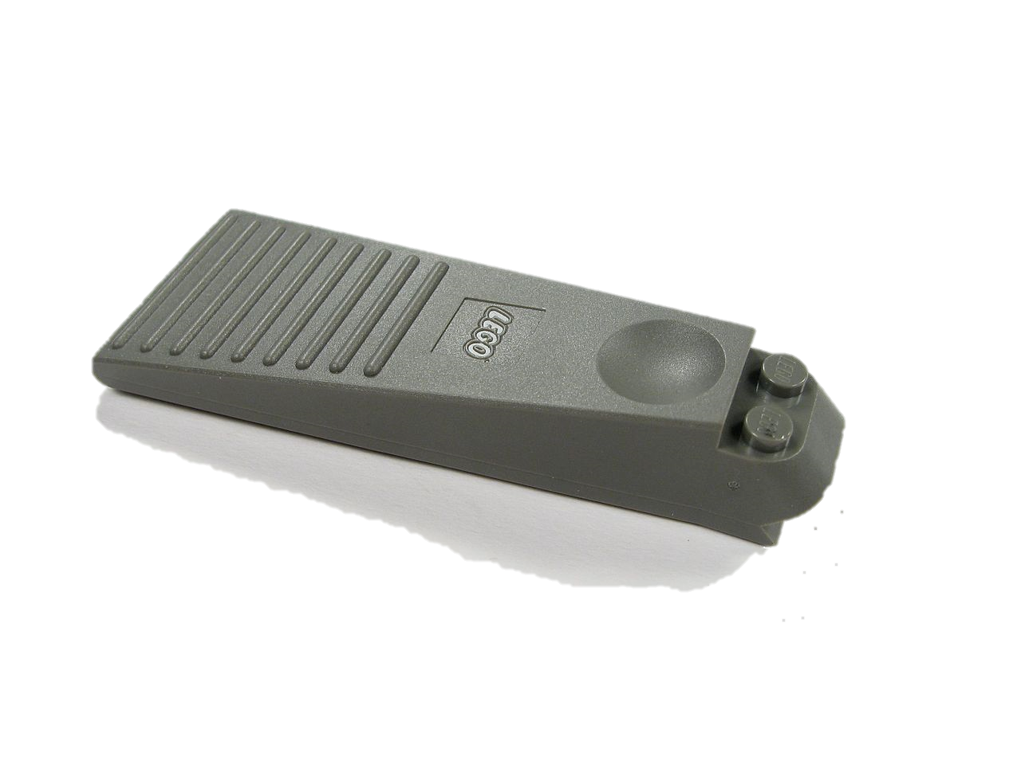
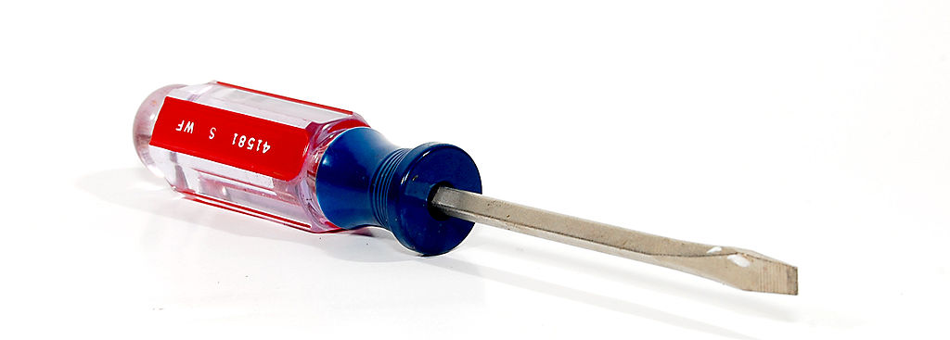
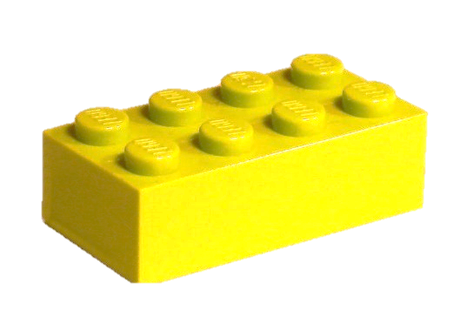
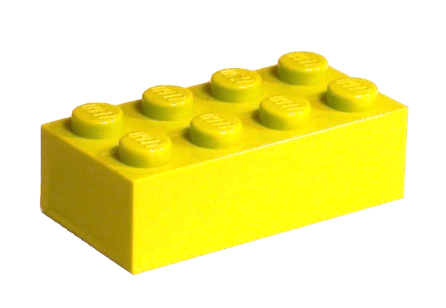
What kind of tools?
Images from https://commons.wikimedia.org
Notes:
As a kid I was using two different tools to break two lego bricks. #1 was a screw driver, You can basically use a screw driver for all kinds of tasks, but it’s also nice to separate lego bricks
#2 was a special tool form lego just for the purpose of breaking lego bricks. Your task during my presentation is to find out, which of the tools I’ll present fits more to one of the two.

Slide 5

Where to use shiny in Pharma?
In the end, it’s about the patient.
Treatment
shinyApp
Blood
dose
shinyApp
QC
shinyApp
shinyApp
Doctor
ggplot
Test Result
Data
t-test
Notes:
Here I displayed a typical workflow of a patient getting treated for any disease.
First you get your blood measured for some parameter. Then your data gets transferred into a test result. These test results you might be interested yourself, or the get shown to your doctor.
The doctor will make a treatment decision. The treatment of course lands at you.
Now you can imagine shiny apps can help in this process at different positions. You can imagine one helping the to improve the quality of measurement devices, one to calculate your test result from raw measurements, one visualizing the test result for the doctors or anothere one helping you with your treatment

Slide 6
Where to use shiny in Pharma?
Two examples
Treatment
shinyApp
Blood
dose
shinyApp
Dia
QC
shinyApp
shinyApp
Doctor
ggplot
Test Result
Data
t-test
Pharma
Notes:
Today, I’ll talk about two examples. One app used in Diagnostics to improve the measurement quality. Another one used in Pharma for clinical study evaluation.
The apps shown in my presentation will not be the real apps used, but rather examples I programmed for the purpose of this presentation. In both cases I will show you, why it is important to test the apps being used.

Slide 7
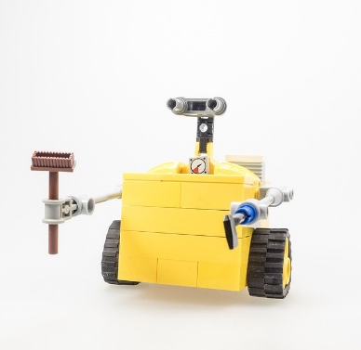
Diagnostics app
Diagnostics workflow
Blood
Test Result
Blood Sugar
Vitamin D
Vitamin A
White Blood Cells
Patient
Analysis robot
Image from: https://pixabay.com/photos/lego-wall-e-figure-cult-computer-628572/
Notes:
Let’s start with the Diagnostics app.
In a Diagnostics workflow, a patient wants certain blood parameters to be measured.
Therefore he gives a blood sample.
This sample gets analyzed in a Diagnostics laboritory, mostly by automatic analysis in robots.
The outcome is a test result with measurement values for e.g. Vitamin D or the count of White blood cells.

Slide 8

Diagnostics App
Quality control of production material
shinyApp
QC
Analysis robot
Notes:
These measurement robots carry chemicals inside them. Here you can see the broom as the example.
At the project I was supporting we build an app for the production of these chemicals. The chemicals were measured in batches. The app displayed if a batch was within the specifications or not.
Therefore the app needs to be validated. Meaning we needed to document what the app is doing to identify bad batches and we needed to test the app deeply against measurements of the chemicals coming in.

Slide 9








Pharma App
Exploratory analysis on patient data during a clinical study
shinyApp
Statistician /
Study manager
?
Test Result
ggplot
Disease Progression
Vitamin A level
Recruited patients
Expected cohorts
Country
Age
Gender
Race
?
stop recruiting
Notes:
The shiny app plots patient variables (age, gender, country) vs disease progression
The app shall suite the statistical analysis plan for intermediate analysis
The study management should know in which countries to stop recruiting for a balanced study
The recruitment shall not stop too early or too late, as it could cost millions

Slide 10
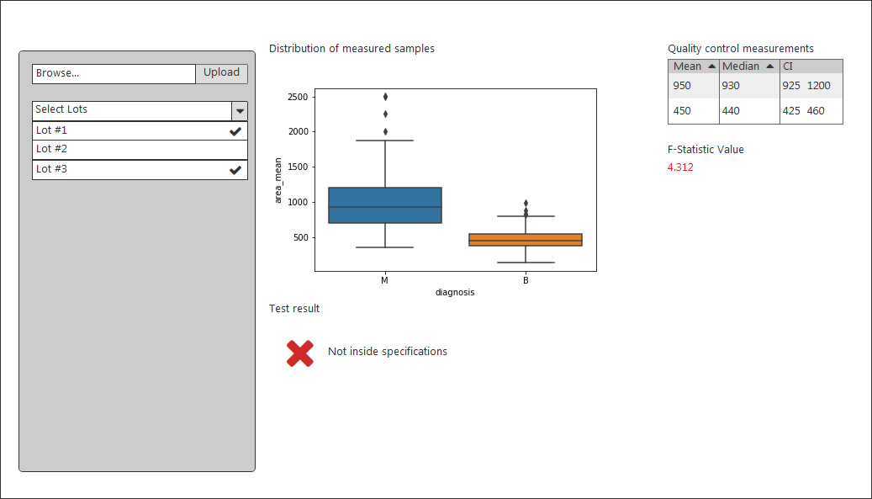
Diagnostics App
https://github.com/zappingseb/EARL2019
Notes:
Boxplot
Confidence value
Image for GOOD / BAD
Text input for Lot # -> filters data
Upload CSV

Slide 11

Diagnostics App
Demo Test
Image from: https://www.pexels.com/photo/woman-behind-laptop-computer-1268472/
Notes:
I will show a shinytest that will click through the app
Upload CSV file
Select the right lots
Check the table
Check the f-Test value
Test the cross image
Test the outcome string

Slide 12
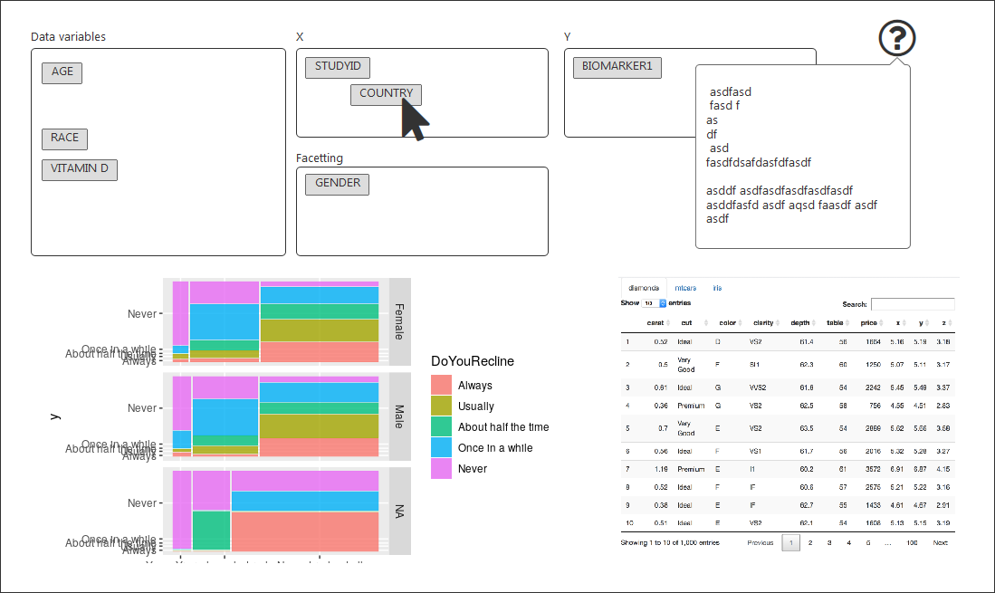
Pharma App
https://github.com/zappingseb/EARL2019
Notes:
Inside the Pharma App we build a drag&drop to allow users to define what they want to plot
The plot shall be testet
As this app is for on-statisticians, there is also a help build in which shall be tested.
Moreover a data-table should ensure that data is not changed form input to output.
App parts:
Drag and drop for variables
Opens pop-up with help
hidden input value
Data table
should run on multiple sites (asia / Europe)

Slide 13
Pharma App
Demo Test
Image from: https://www.pexels.com/photo/woman-behind-laptop-computer-1268472/
Notes:
A Rselenium test will ensure, that drag&drop works. It will compare two different plots after two different drag and drops.

Slide 14
RSelenium or shinytest
Which one is better?

Slide 15
RSelenium or shinytest
RSelenium
shinytest
+ multi browser
+ drag & drop
+ hover
+ javascript click
entering text
wait
no integrated reporting
+ API
+ Recorder
+ app_snapshot
+ compatible with testthat
single browser
wait
reading tables

Slide 16
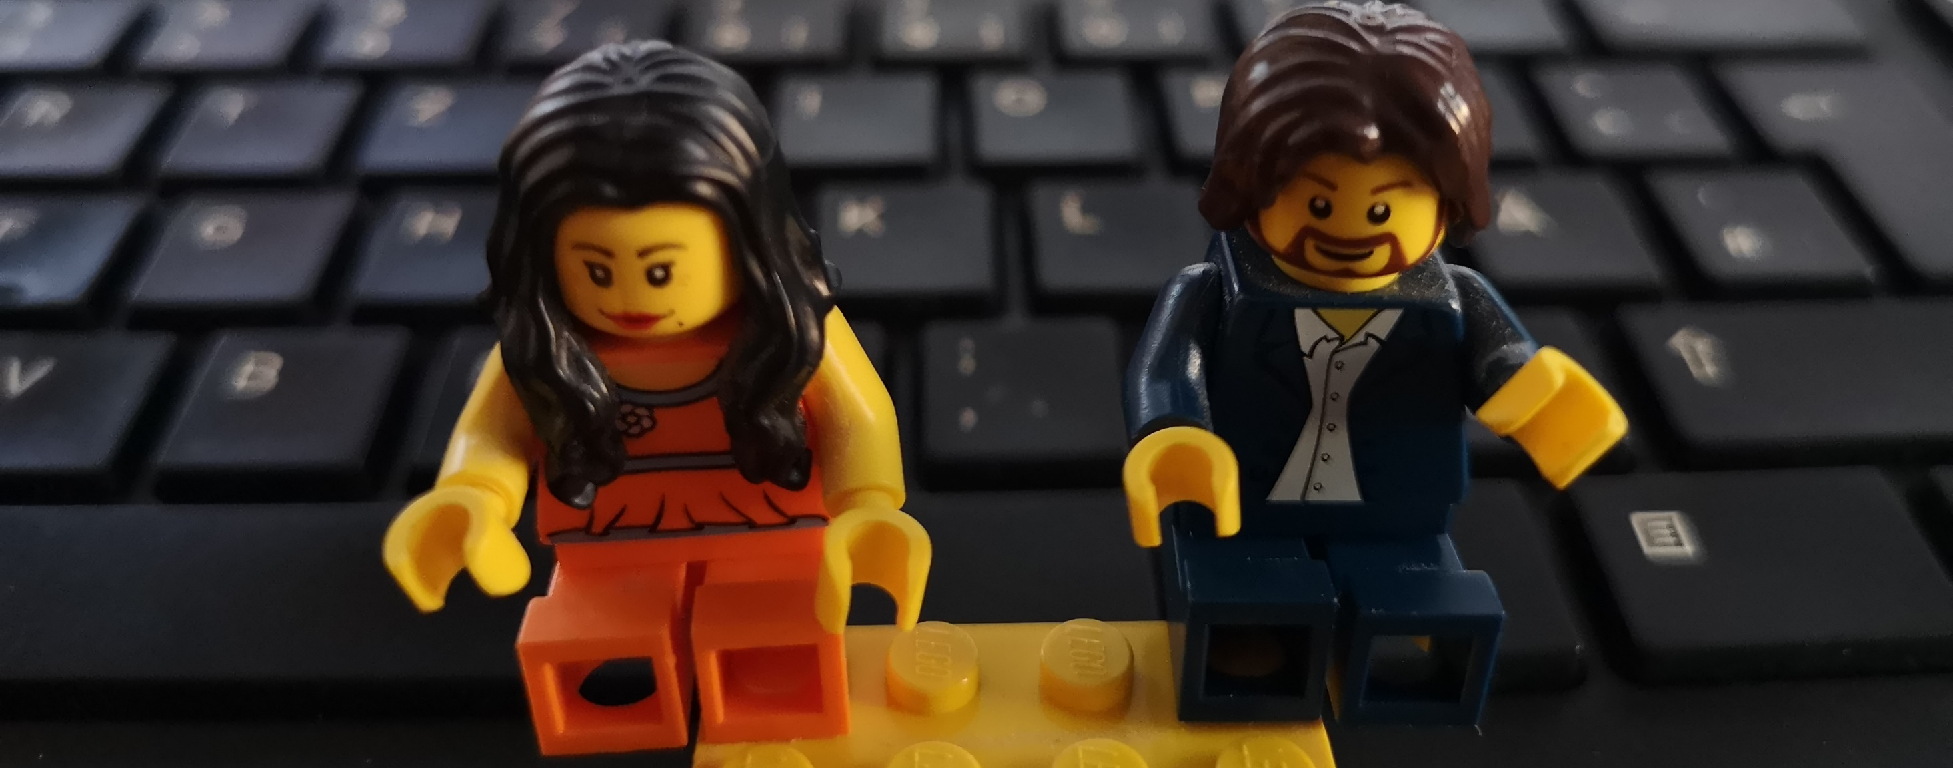
Take away 1
No one is better, you need to discuss the solution.
Bla bla......
Yes yes yes .... no

Slide 17
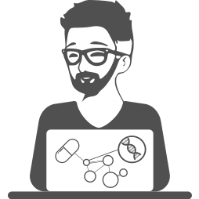
Take away 2
Ask me
Thank you!
#' @email
#'
#' @blog
#'
#' @bugReport
#'
#' @cv
#'
#' @twitter
sebastian@mail-wolf.de
medium.com/@zappingseb
github.com/zappingseb
linkedin.com/in/zappingseb
twitter.com/zappingseb
Code and slides of this presentation at https://github.com/zappingseb/EARL2019

Slide 19
About tools
2 Tools
General view on tools
Why do we need the tools?
Use-cases
Draw a line
Where is the benefit of each tool?
What kind of tools did we have?
There is no „better“ tool!
Choose wisely

